Slide 1
SMART METERS IN LONDON
Analysis of electric energy consumption

Slide 2
INTRO

Slide 3
Smart Meters
It is an electronic device that records the consumption of electric energy.
Allows for greater clarity of consumption for system monitoring and customer billing.
Typically record energy near real-time, and report regularly in short intervals throughout the day.
Our dataset contains the energy consumption readings for a sample of 5,567 London households that took part in the UK Power Networks led Low Carbon London project between November 2011 and February 2014. Data is provided in half hourly smart meter measurements in kilowatt-hours, which is a commonly used as a billing unit for energy delivered to consumers by electric utilities.
Notes:
Our dataset contains information from smart meters from households in London. A smart meters is a device which allows to record energy consumption in near real-time and report it in short intervals throughout the day. They are used to allow for a greater clarity of consumption which then helps with system monitoring and customer billing.
We have electricity consumption data for over 5.5 thousand households which took part in the study between November 2011 and February 2014. Data is provided in half hourly measurements and is expressed in kilowatt-hours which is a commonly used billing unit for energy delivered to households.

Slide 4
Objectives
Explore patterns of energy consumption.
Explore effects of different weather variables on the energy consumption.
Build a model predicting energy consumption.

Slide 5

ENERGY
USAGE

Slide 6
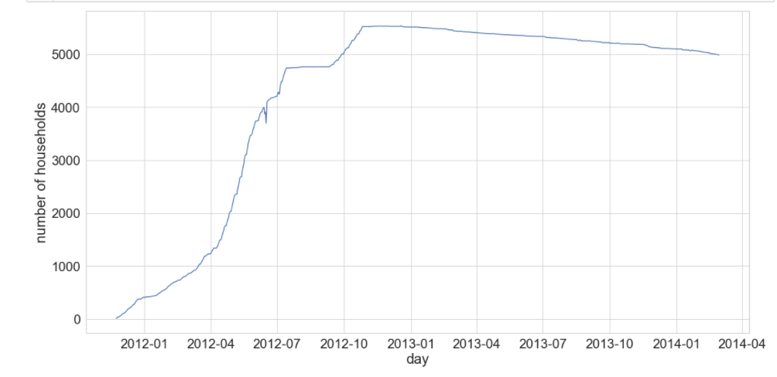
Distribution of data
x
Notes:
Here we can see the count of household with data per day of the study. The data is distributed unevenly with much fewer households included at the beginning and more joining as time goes on with a peak around the beginning of 2013. Despite this inequality we decided to use the early data as well to maximize the number of datapoints.

Slide 7
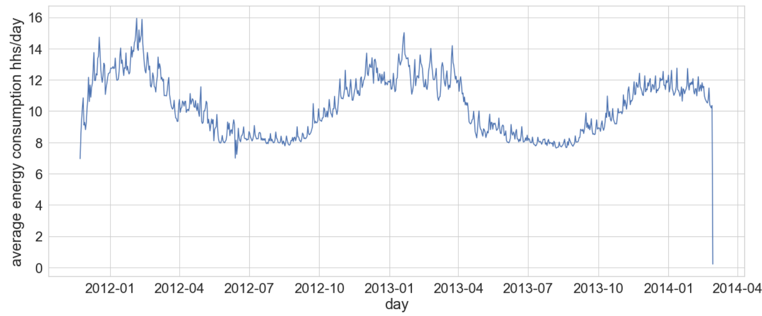
Energy consumption
There is clear seasonality with peaks in energy usage in the colder months and lower consumption in the warmer ones.
Notes:
As I mentioned, the data is provided in half hourly intervals for each household. We decided to aggregate the data to look at average energy consumption per household per day. We can clearly see the seasonality of the data with peaks in the colder months and lower consumption in the warmer ones. This is likely caused by a few things: usage of electricity for heating, days are shorter so the usage of lights in increased, people tend to spend more time indoors during the winter.
There is an anomaly in the data, the recorded consumption on the last day of the study is unusually low, it is unclear why so we decided to drop that data point when running the models.

Slide 8
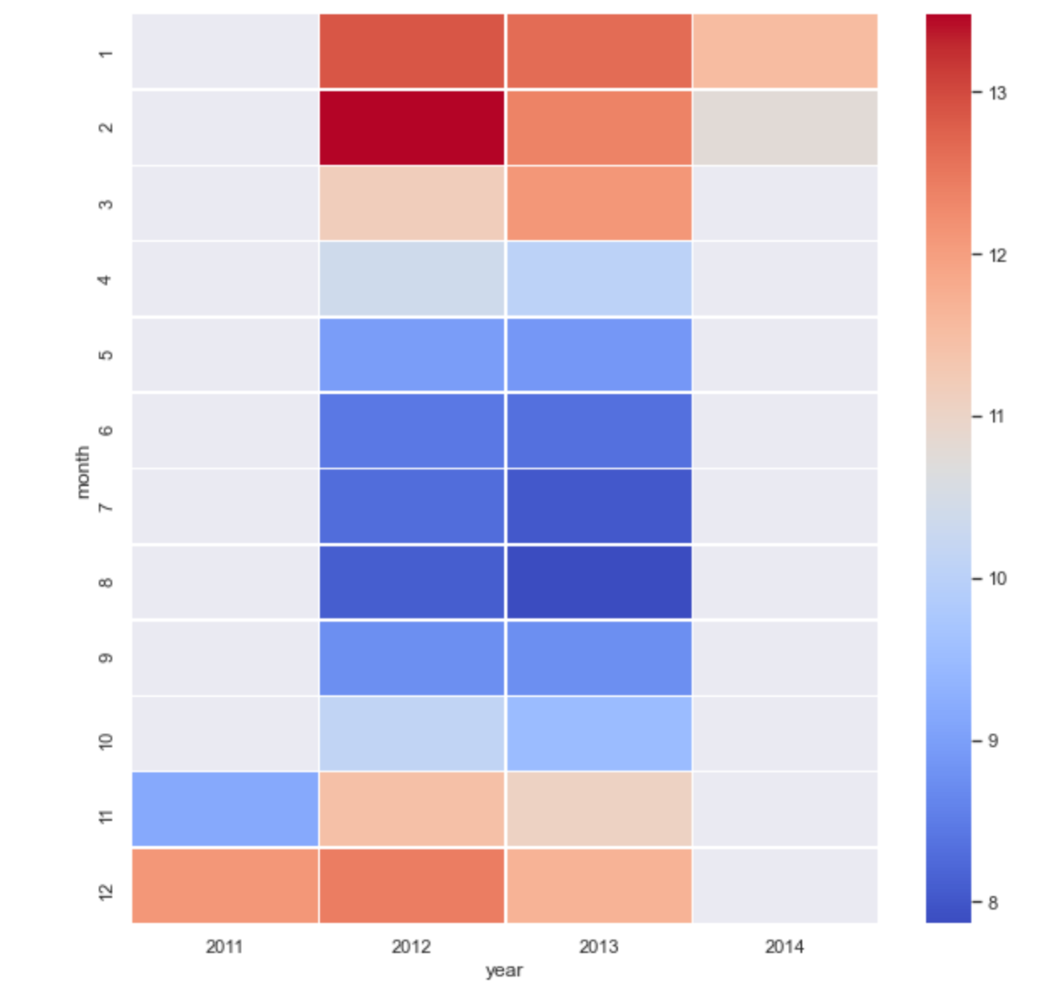
Energy consumption by month
Notes:
Here, again, you can see clearly that energy consumption was highest in the colder months, especially January and February; and lowest in the summer, around July and August.

Slide 9
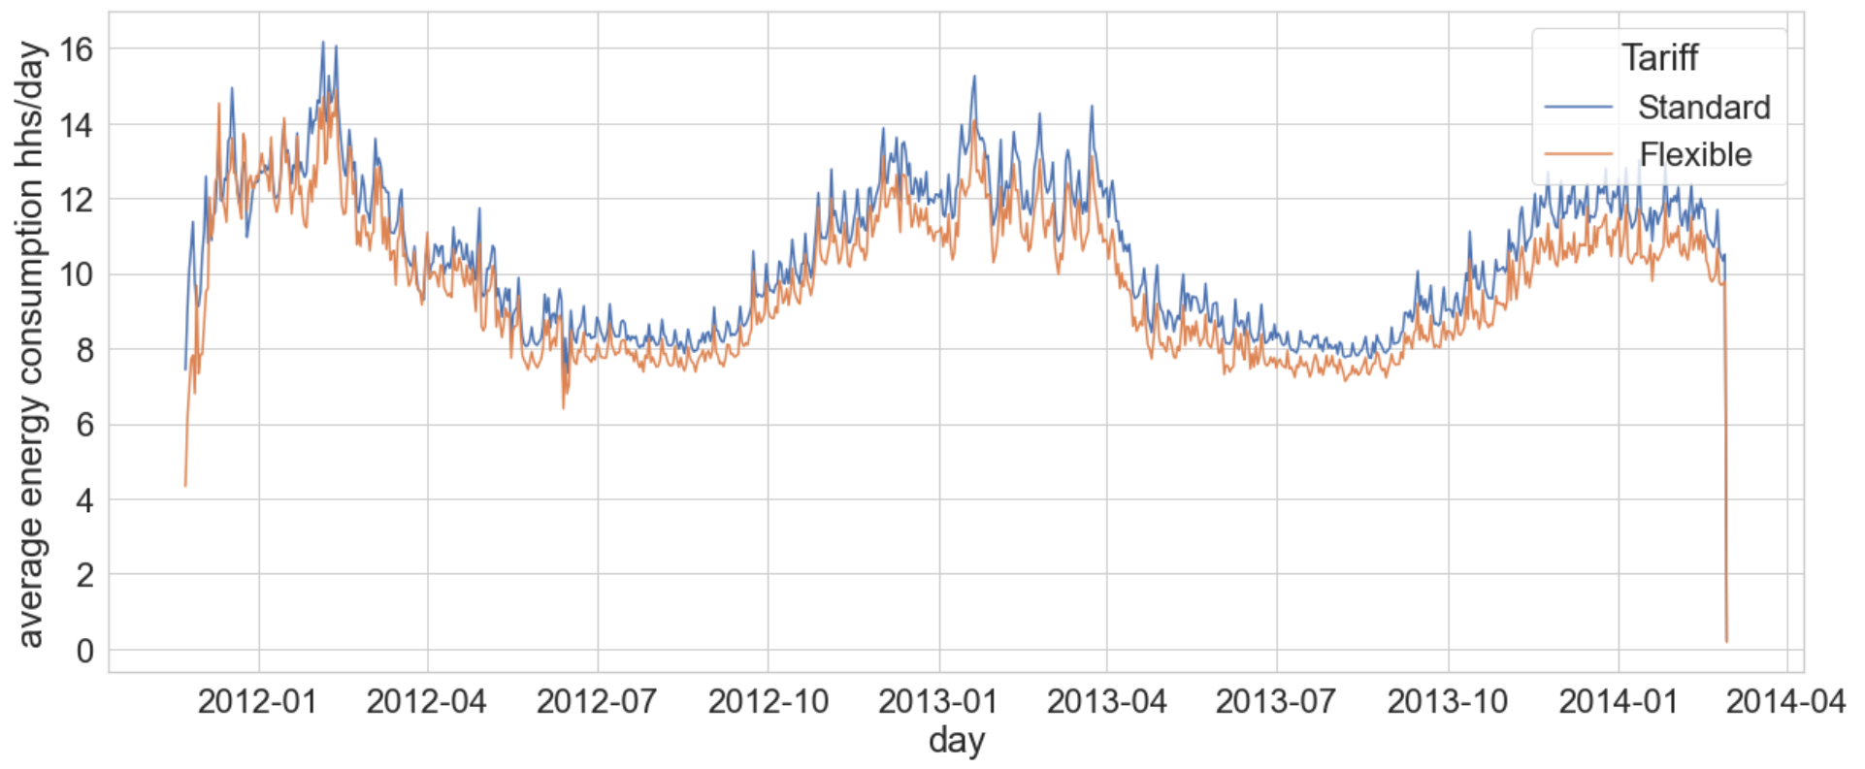
Energy by tariff
Households with flexible tariff use less energy than households with a standard tariff.
Notes:
For each household we had information what type of tariff is applied. Standard tariff means that the price of energy is the same throughout the day. In case of a flexible tariff, the price varies throughout the day with prices being lower when there is less demand, e.g. at night.
We can see that households with the flexible tariff consistently used less energy, however, the difference is not very big.

Slide 10
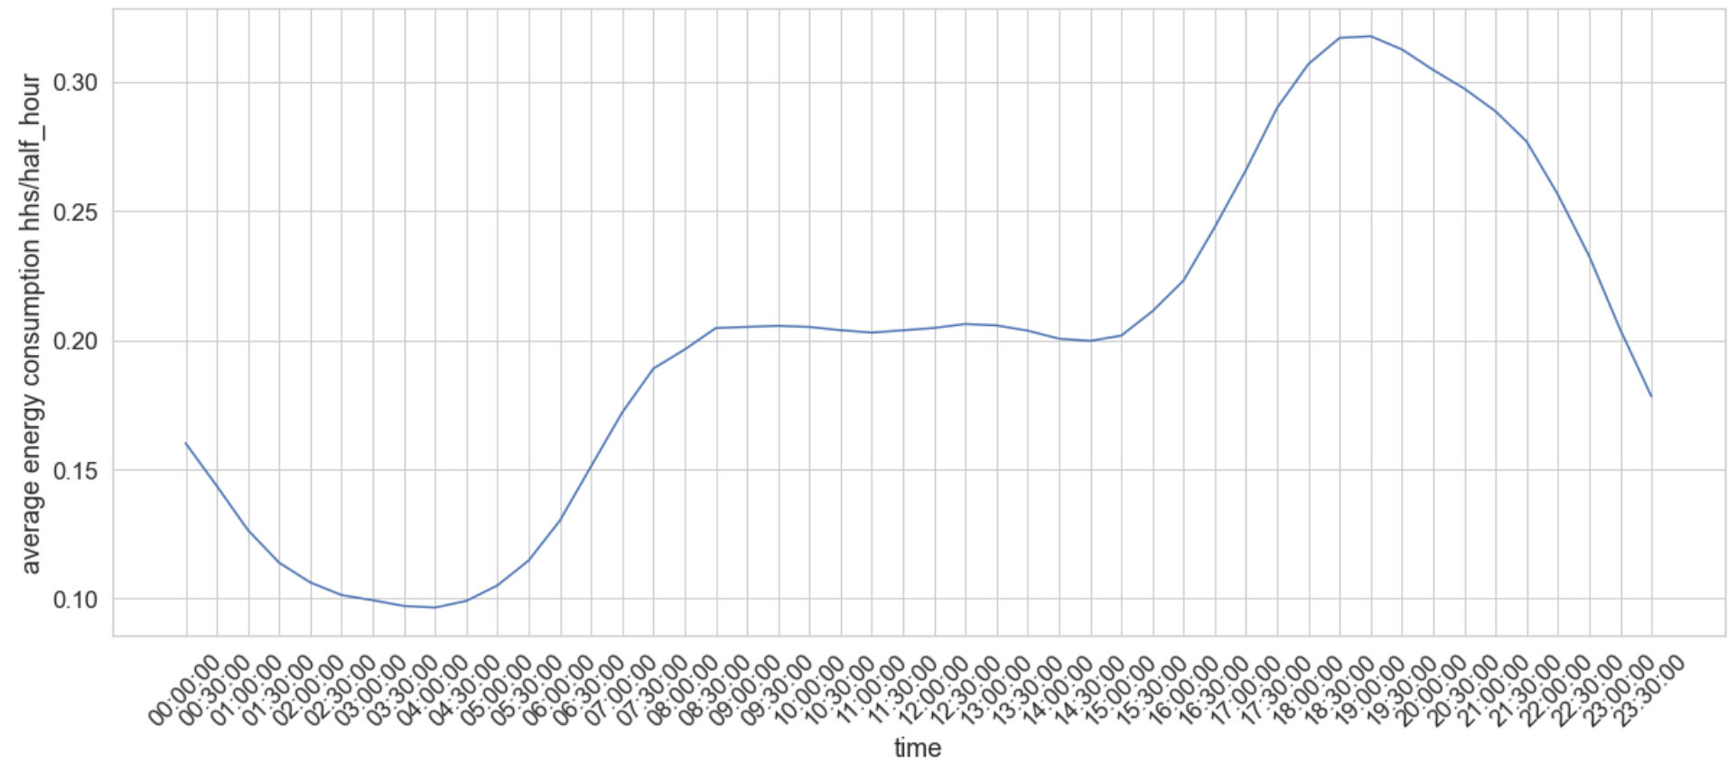
Energy through the day
x
Notes:
Here you can see the pattern of energy consumption during the day based on a sample of households. As expected, the consumption is lowest at night, starting to grow around 6 in the morning, then stabilising around 8, and then growing again from around 4pm, when people start coming back home from work or school. It then peaks around 6pm and starts to go down again.

Slide 11
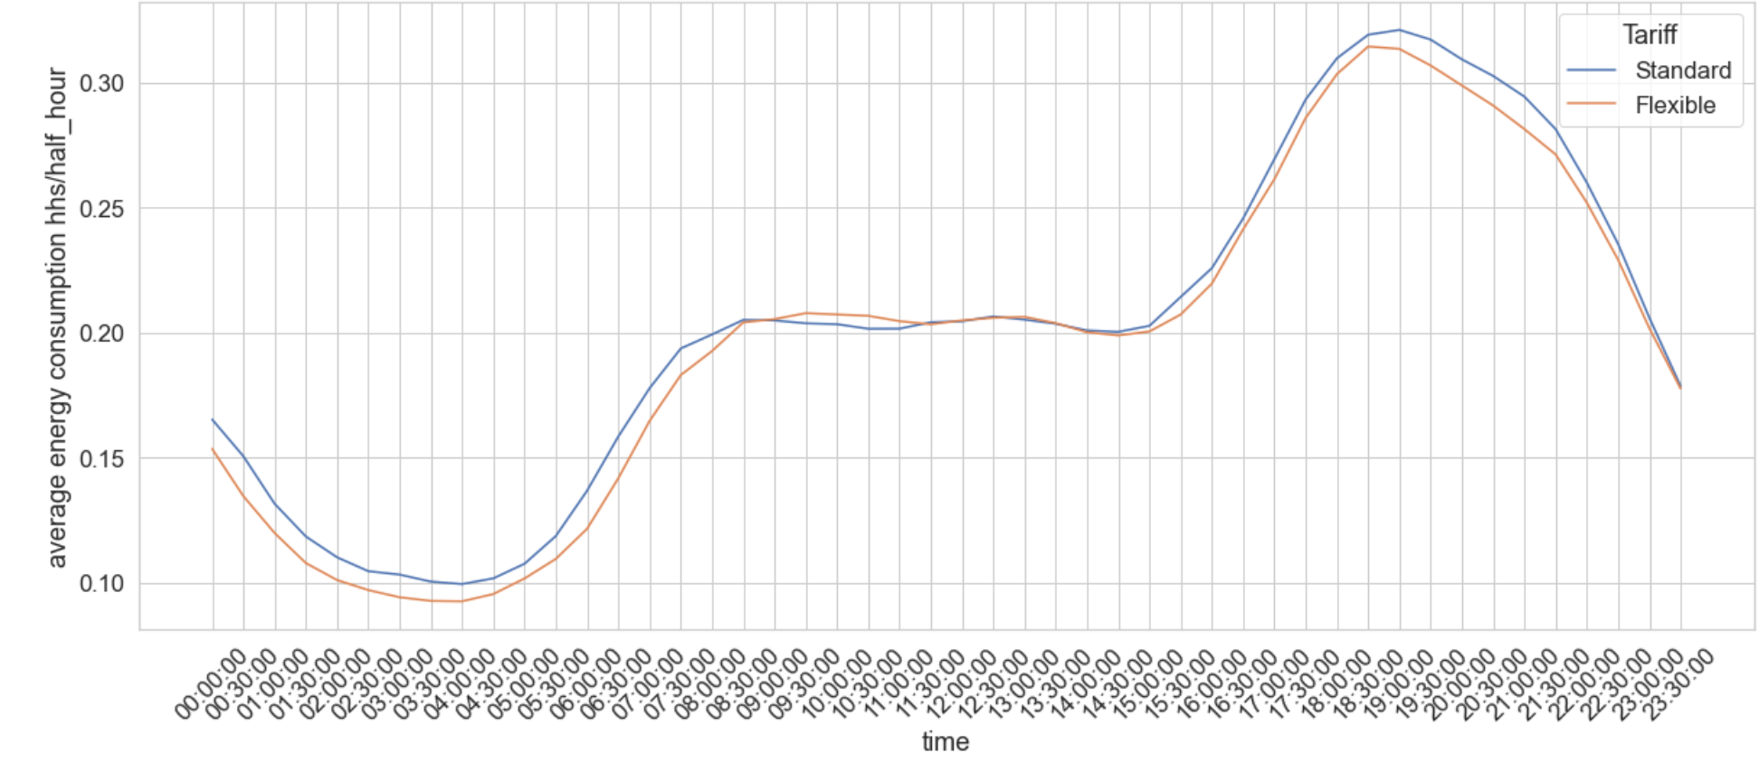
Energy through the day by tariff
x
Notes:
Looking at the daily energy pattern by tariff type, it is the same for both types. As we saw before, households with flexible tariff tend to use a bit less energy than those with a standard one.

Slide 12

ACORN

Slide 13
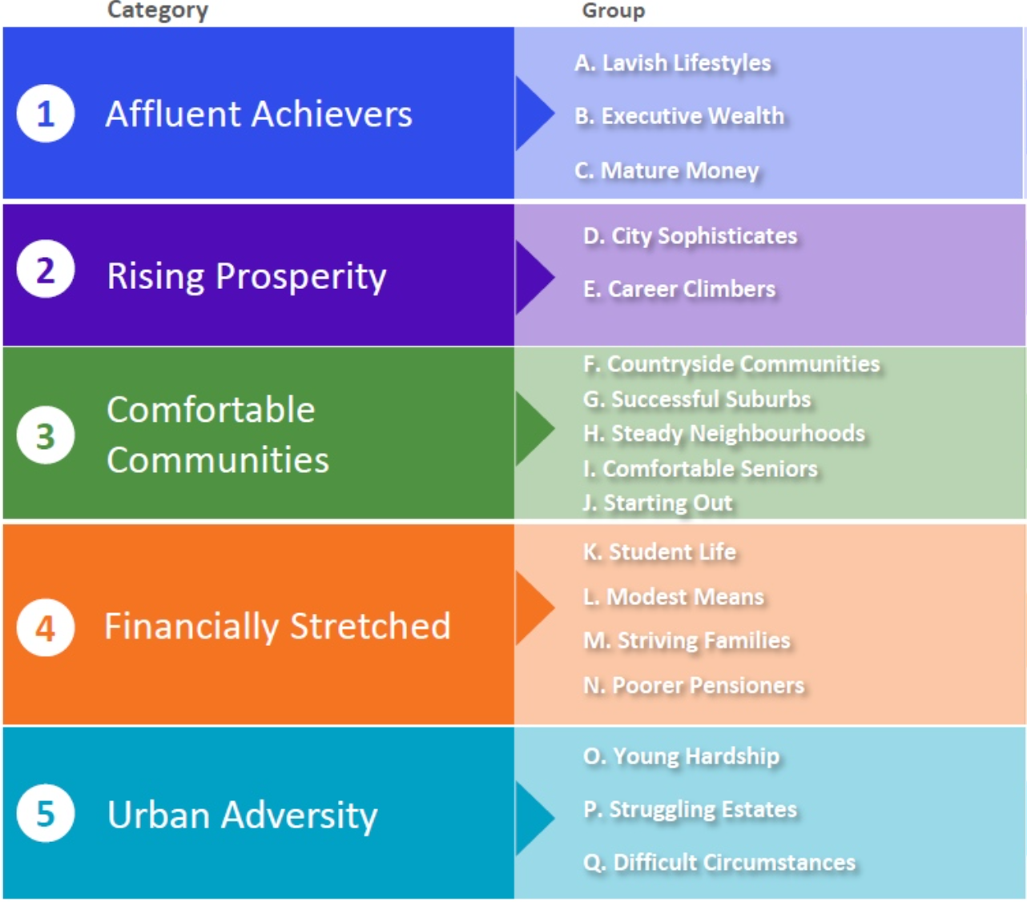
What is ACORN?
Acorn is a consumer classification that segments the population into different types, providing a detailed understanding of the consumer characteristics of people and places across the UK.
By analysing demographic data, social factors, population and consumer behaviour it provides an understanding of different types of people and places.
Notes:
The households in our dataset had Acorn information assigned. Acorn is a consumer classification that segments the population in the UK into different categories, which then split into smaller groups and then types. Things like demographic data, social factors, population and consumer behaviour are used to build this classification. In our analysis we decided to look at the high level split which are the categories. The household in the study fell into three categories: Affluent Achievers, Comfortable Communities and Urban Adversity.

Slide 14
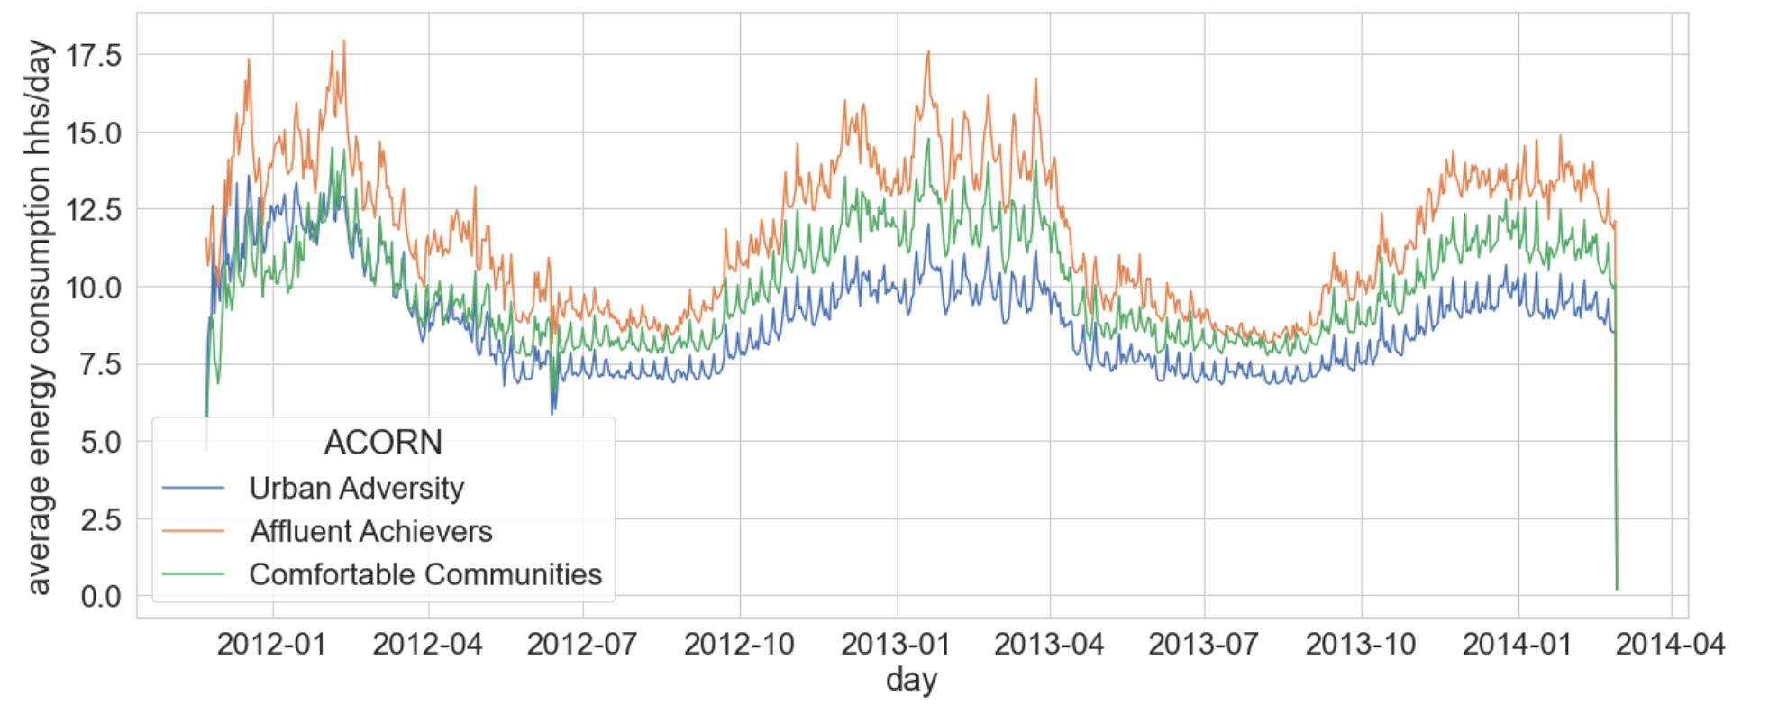
Energy consumption by ACORN category
More affluent households tend to use more energy than the poorer ones.
Notes:
Affluent Achievers households use the most energy, followed by Comfortable Communities and Urban Adversity using the least. This makes sense, as the more affluent households tend to have larger homes as well as more devices and appliances which consume energy.

Slide 15
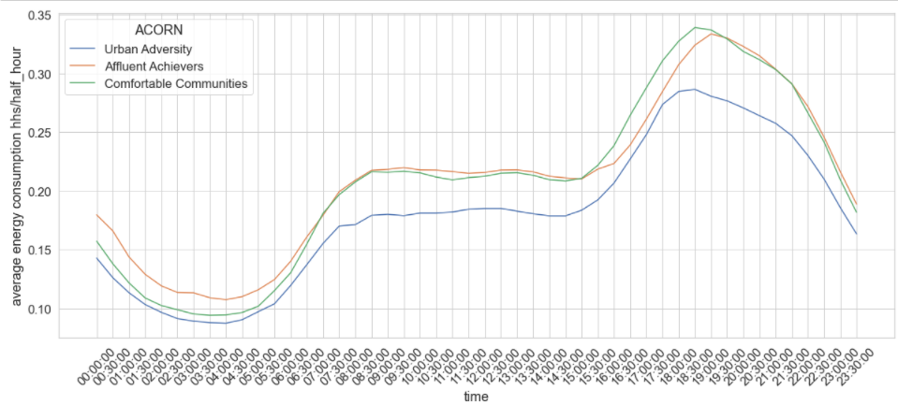
Energy through the day by ACORN
Urban Adversity household have the lowest energy consumption throughout the day.

Slide 16

HOW DO
METEOROLOGICAL
FACTORS IMPACT ENERGY CONSUMPTION?

Slide 17
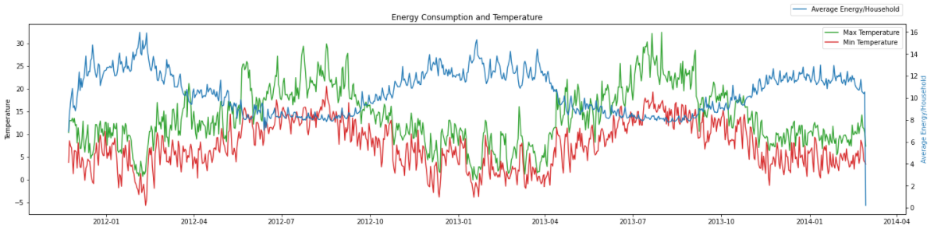
TEMPERATURE
x
Energy and temperature have an inverse relationship-we can see the peaks in one appearing with troughs in the other. This confirms the intuition that during low temperature, it is likely that the energy consumption through heaters etc. increases.

Slide 18
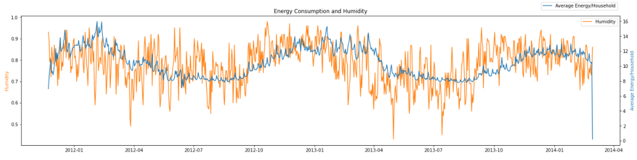
HUMIDITY
x
Humidity and the average consumption of energy seems to have the same trend.

Slide 19
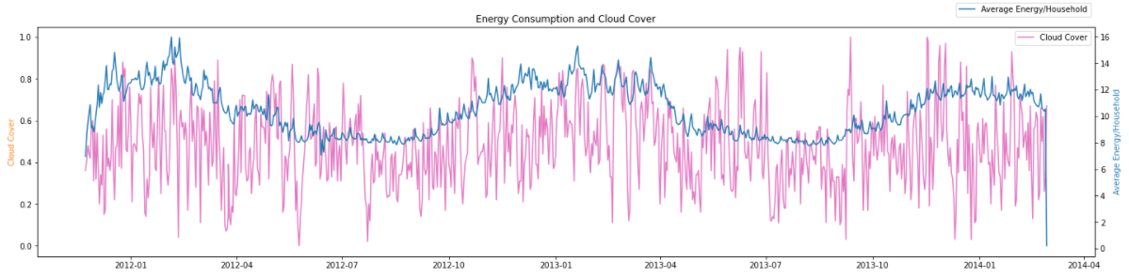
CLOUD COVER
x
The cloud cover value seems to be following the same pattern as the energy consumption.

Slide 20
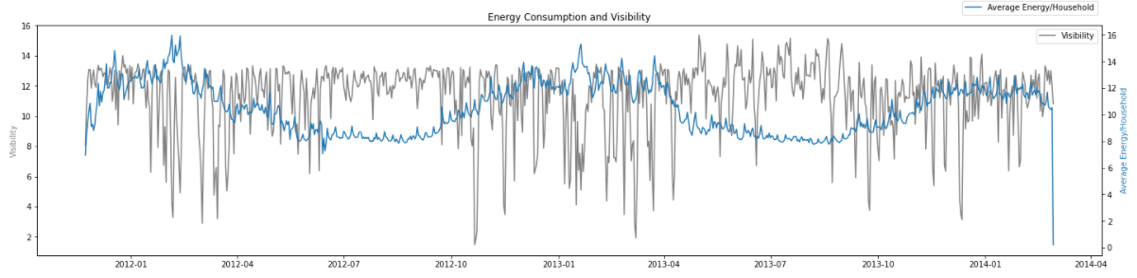
VISIBILITY
x
The visibility factor does not seem to affect energy consumption at all- since visibility is most likely an outdoors factor, it is unlikely that it's increase or decrease affects energy consumption within a household.

Slide 21
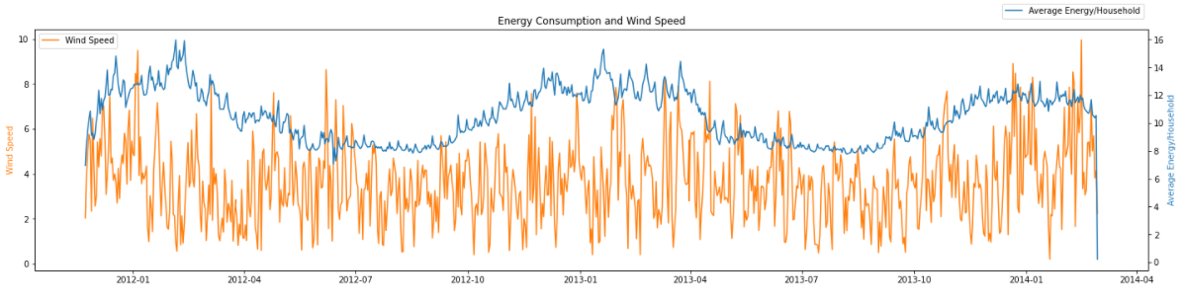
WIND SPEED
x
Wind speed seems to be an outdoors factor which does not affect in the energy consumption as such.

Slide 22
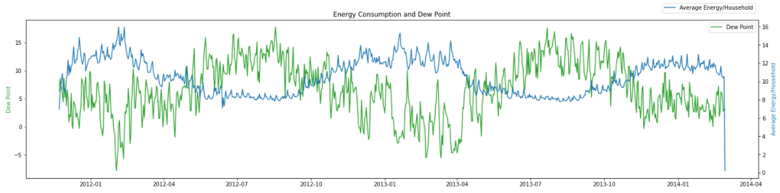
DEW POINT
x
Dew Point- is a function of humidity and temperature therefore it displays similar relation to energy consumption.

Slide 23
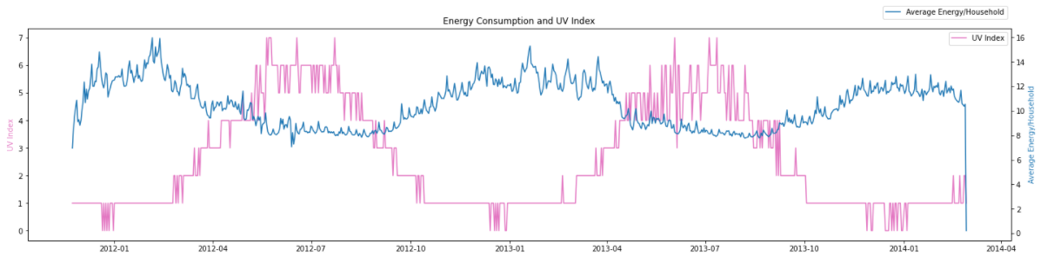
UV INDEX
x
The UV index has an inverse relationship with energy consumption

Slide 24
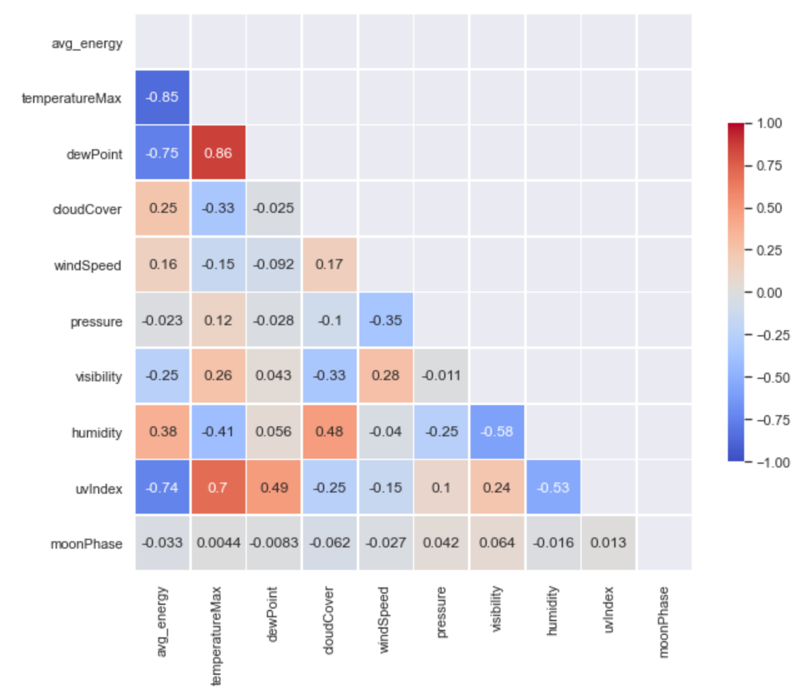
FINDING CORRELATIONS
Energy has high positive correlation with humidity and high negative correlation with temperature.
Dew Point, UV Index display multicollinearity with Temperature, hence discarded
Cloud Cover and Visibility display multicollinearity with Humidity, hence discarded
Wind Speed has low correlation with energy but does not show multicollinearity
x

Slide 25
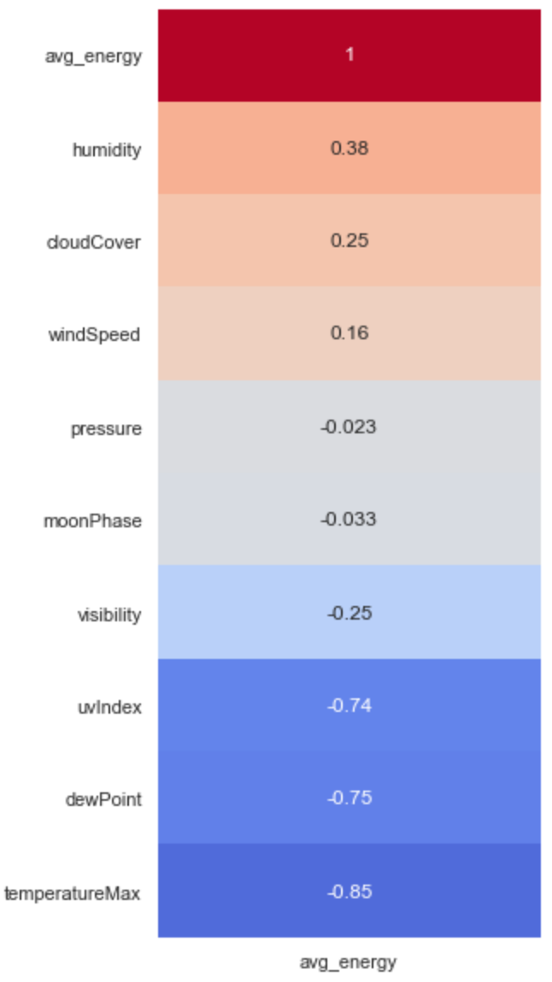
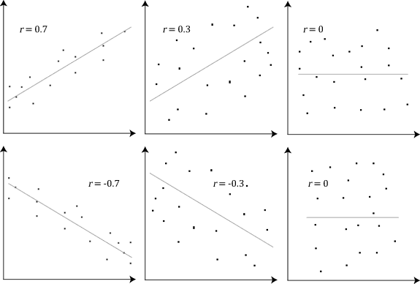
PEARSON CORRELATION
x

Slide 26
FORECASTING ENERGY CONSUMPTION

Slide 27
What is XGBoost?
Stands for eXtreme Gradient Boosting.
It is an implementation of gradient boosted decision trees designed for speed and performance. XGB is much faster when compared to other implementations of gradient boosting.
Recently has been dominating applied machine learning and Kaggle competitions for structured or tabular data.
Boosting is an ensemble technique where new models are added to correct the errors made by existing models. Models are added sequentially until no further improvements can be made.
Gradient boosting is an approach where new models are created that predict the residuals or errors of prior models and then added together to make the final prediction.

Slide 28
Errors
Mean Absolute Error (MAE): MAE measures the average magnitude of the errors in a set of predictions, without considering their direction. It’s the average over the test sample of the absolute differences between prediction and actual observation where all individual differences have equal weight.
Mean Squared Error (MSE): MSE represents the average of the squared difference between the original and predicted values in the data set. It measures the variance of the residuals.It penalizes large prediction errors.
Notes:
We will be using two common measures of accuracy: mean absolute error and mean squared error. Mean Absolute Error measures the absolute average distance between the real data and the predicted data, without considering the direction. Mean Squared error measures the squared average distance between the real data and the predicted data so it penalizes the large prediction errors. But the disadvantage is that it also squares up the units of data.
Choosing one over other depends on the specific data, for example, if being off by 10 is more than twice as bad as being off by 5 we would use MSE. But if being off by 10 is just twice as bad as being off by 5, then MAE is more appropriate.
In this case we thought both can be relevant so we decided to look at values for both.

Slide 29
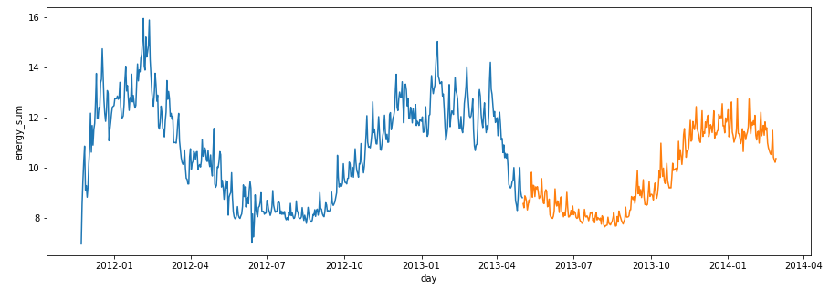
Train/test split
Test data is around 40% of data, starting from 1 May 2013.

Slide 30
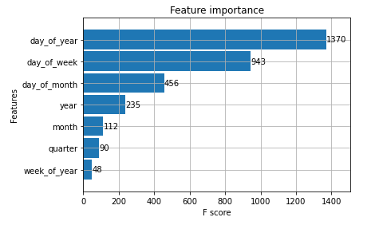
Basic model
Mean absolute error:
0.6209
Mean squared error:
0.7634
Notes:
As a first try I run a simple XGB model without adjusting any parameters. Here you can see the features I used and how important they are for the model. Generally, importance provides a score that indicates how useful or valuable each feature was in the construction of the boosted decision trees within the model. The more an attribute is used to make key decisions with decision trees, the higher its relative importance.
Importance is calculated for a single decision tree by the amount that each attribute split point improves the performance measure, weighted by the number of observations the node is responsible for. The feature importances are then averaged across all of the the decision trees within the model.

Slide 31
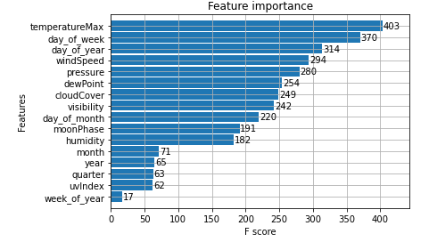
Basic model with weather
Mean absolute error:
0.3712
Mean squared error:
0.2389
Notes:
In the next iteration of the model I added the weather data as we saw previously that it has an effect on the energy consumption. Now temperature is the most important feature, followed by day of the week.
Straight away we can see that the weather data significantly improves the predictions with the errors becoming much smaller, especially the mean squared error.

Slide 32
Parameters - n_estimators
n_estimators=100
n_estimators=1000
n_estimators specifies how many times to go through the modeling cycle. Too low a value causes underfitting, which is inaccurate predictions on both training data and new data. Too large a value causes overfitting, which is accurate predictions on training data, but inaccurate predictions on new data. Typical values range from 100-1000
Mean absolute error:
0.2389
Mean absolute error:
0.2386
Mean squared error:
0.3712
Mean squared error:
0.3709
Notes:
XGBoost offers many ways of fine tuning your model as it has a lot of parameters that can be adjusted. As the next step I wanted to see how some of them would influence my model. First, I decided to look t n-estimators.

Slide 33
Parameters - early stopping rounds
early_stopping_rounds=5
early_stopping_rounds=50
early_stopping_rounds causes the model to stop iterating when the validation score stops improving, even if we aren't at the hard stop for n_estimators.
Mean absolute error:
0.1373
Mean absolute error:
0.1373
Mean squared error:
0.2819
Mean squared error:
0.2819
Notes:
As the next step, I added another parameter: early stopping rounds.
Changing this parameter didn’t affect the accuracy of the model.

Slide 34
Parameters - learning rate
learning_rate=0.5
learning_rate=0.05
learning_rate - a small learning rate will yield more accurate XGBoost models, though it will also take the model longer to train since it does more iterations through the cycle.
Mean absolute error:
0.2221
Mean absolute error:
0.1380
Mean squared error:
0.3491
Mean squared error:
0.2835
Notes:
The third parameter I looked at was learning_rate. It indicates how big are the differences between the different iterations of the model.
In this case, we can see that this parameter has an impact on the model.

Slide 35
Grid search
early_stopping_rounds: range (5, 50, 5) ⇒ 5
max_depth: range (2,10,1) ⇒ 4
criterion: ['entropy', 'gini'] ⇒ entropy
n_estimators: range (100, 1000, 100) ⇒ 100
learning_rate: range (0.05, 0.55, 0.1) ⇒ 0.25
Grid search is a tuning technique that attempts to compute the optimum values of hyperparameters. It is an exhaustive search that is performed on the specific parameter values of a model.
Max_depth: maximum depth of a tree. Increasing this value will make the model more complex and more likely to overfit. Training a deep tree significantly affects memory usage.
Entropy is a measure of impurity in the data. Gini a measure of misclassification. They are similar but gini calculates faster.
Mean absolute error:
0.1341
Mean squared error:
0.2779
Notes:
There are endless combinations of parameters that are possible and going through them manually like I just did can be very tedious and time consuming. That’s when grid search comes in handy. Grid search is a parameter tuning technique that helps to find the optimum values for them. It builds a model for every combination of parameters specified and evaluates each model.

Slide 36
Comparing errors
Parameters | Mean Squared Error | Mean Absolute Error
(grid search); n_estimators=100, early_stopping_rounds=5, learning_rate=0.25, max_depth=4, criterion='entropy' | 0.1341 | 0.2779
n_estimators=1000, early_stopping_rounds=5 | 0.1373 | 0.2819
n_estimators=1000, early_stopping_rounds=50 | 0.1373 | 0.2819
n_estimators=1000, early_stopping_rounds=5, learning_rate=0.05 | 0.1380 | 0.2835
n_estimators=1000, early_stopping_rounds=5, learning_rate=0.5 | 0.2221 | 0.3491
n_estimators=1000 | 0.2386 | 0.3709
n_estimators=100 | 0.2389 | 0.3712
no parameters | 0.2389 | 0.3712
no parameters, no weather | 0.7634 | 0.6209

Slide 37
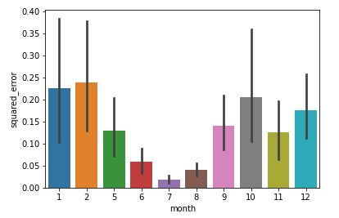
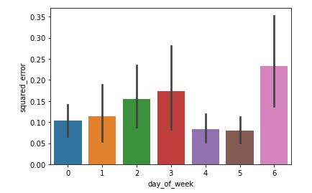
Errors per month and weekday
Months and days of week with higher standard deviation in data have a higher mean squared error.
Notes:
Here we can see what the squared error is per month and per weekday.
The error is higher in the months that tend to see a higher energy usage but in turn there is also a higher variation in the data in these months. Similarly looking at the error by day of week, the days with higher errores are the days with higher variation in the data.

Slide 38
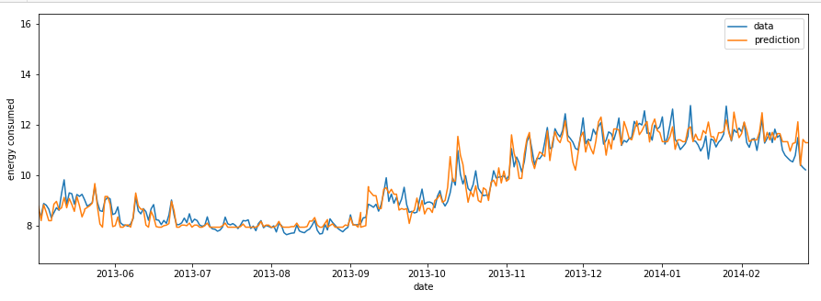
Graph of predictions
Notes:
Here you can see the visual representation of how the model relates to real data. In blue is the real data and in orange my prediction.

Slide 39
What does this all mean?
Average payment per household: £548.07
+1.95%
-0.18%
Worst model: £558.75
Best Model: £547.07
Notes:
So what does this all actually mean? The price per kilowatt hour in 2014 was around 21 pence. Assuming that price average household should have paid 548.07 pounds during our test period (10 months). Our starting model predicted a total bill almost 2% higher at 558.75. While, the final model was much better with prediction just 0.18% off the actual values.
As a result the energy company can predict fairly accurately how much energy will be needed when. It is also good for customers as they will not get a bill schock, which is when a customer gets a high unexpected bill. As a result, both customers and the energy company can have a pretty good expectation of what the actual payments should be, avoiding further costs, e.g. admin.

Slide 40
WHAT’S NEXT?

Slide 41
NEXT STEPS
Use more models like FB Prophet, ARIMA
Develop models around other features like Acorn, family size, etc.
Build models using more granular data (half-hourly)
Further optimise parameters using Grid Search or Random Grid Search

